Slide 1
Future climate: temperature and precipitation
Silvia Caldararu
Email: caldaras@tcd.ie

Slide 2

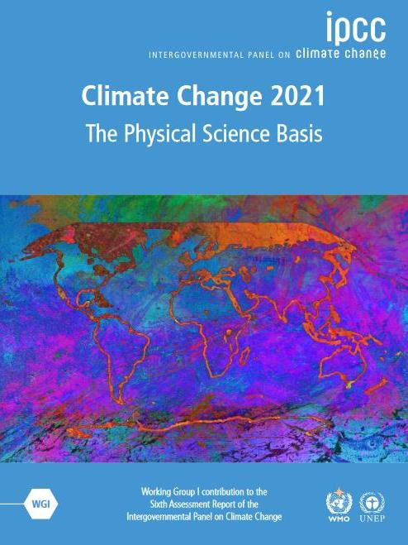
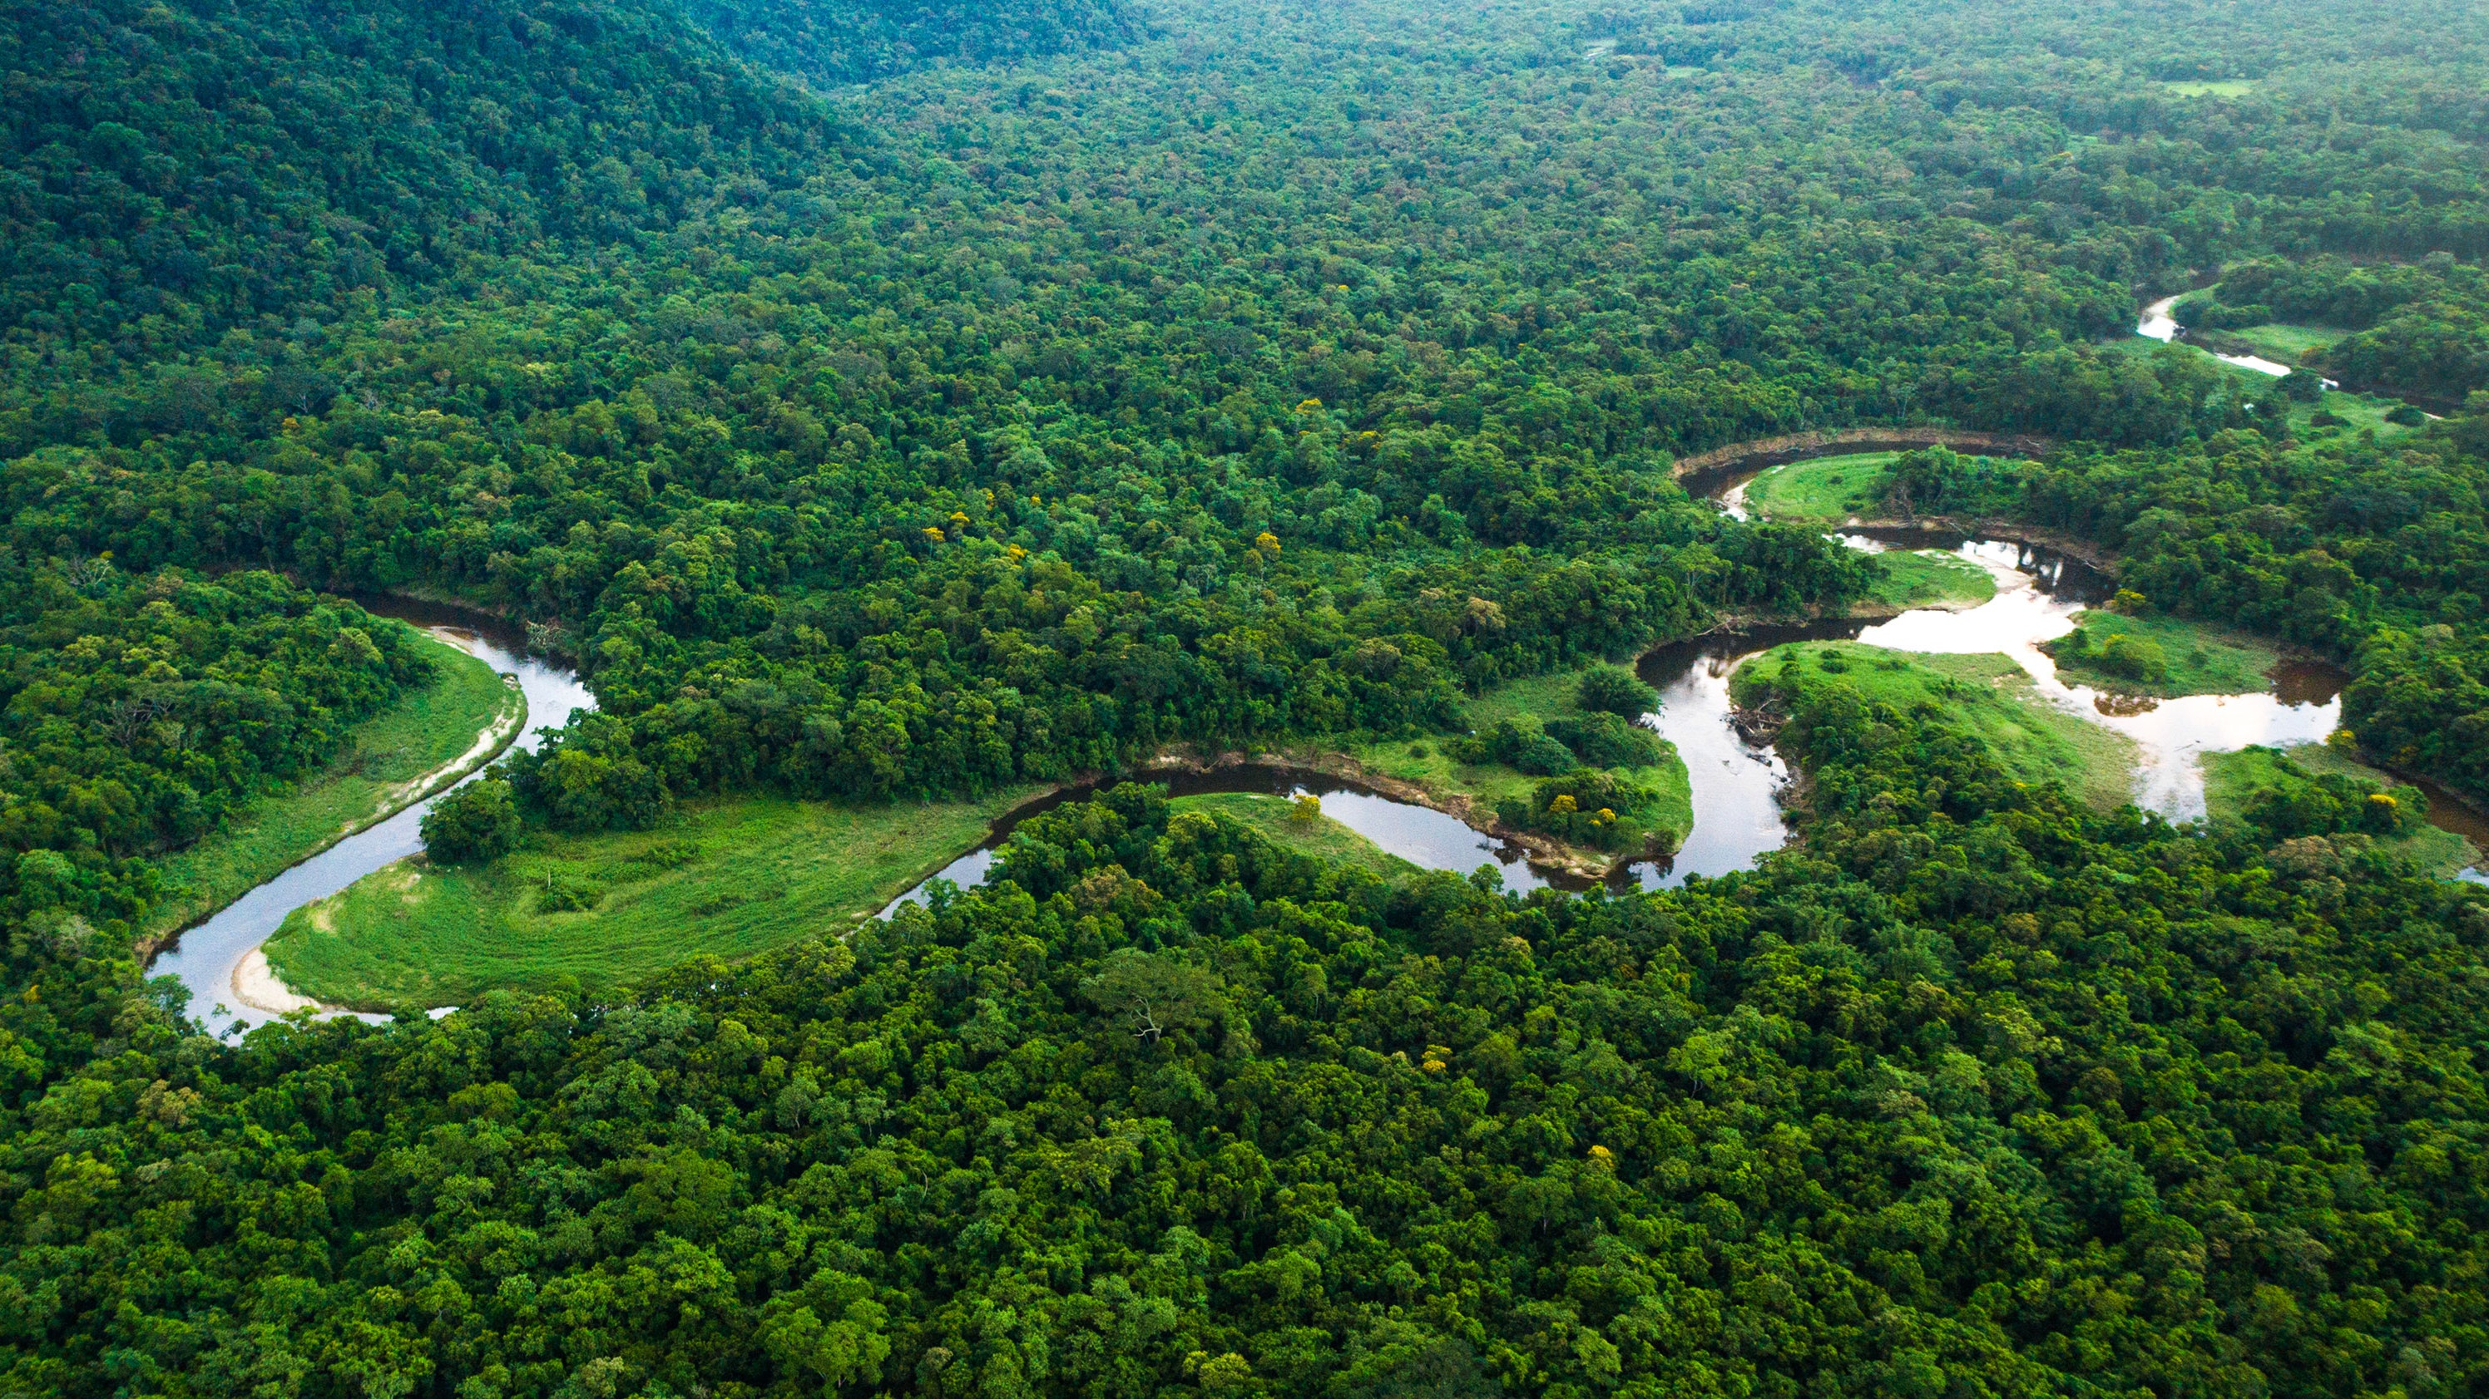

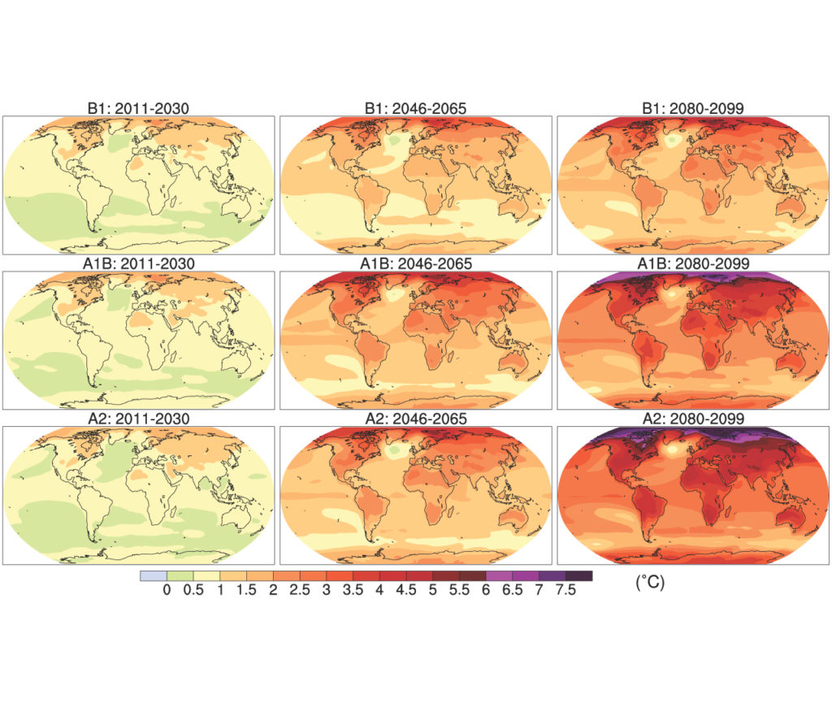
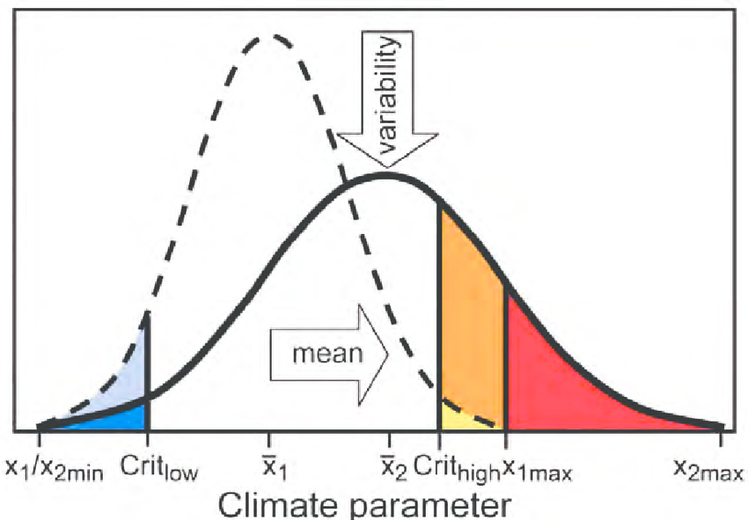
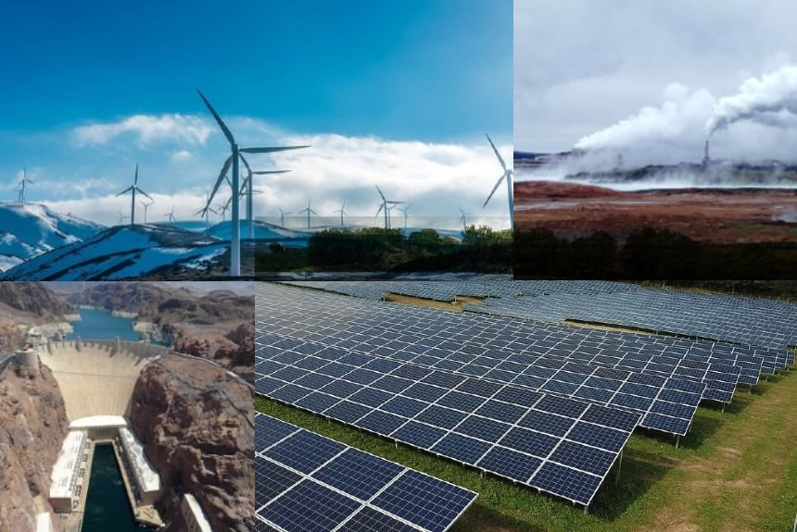
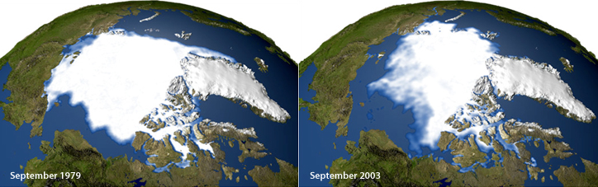
Atmosphere
Climate fundamentals
Predicting climate
Atmosphere
Global C cycle
IPCC report
Earth system models
Climate impacts
Climate solutions
Extreme events
Tipping points
Sea ice, ice caps
Energy
Mitigation
Nature-based solutions

Slide 3
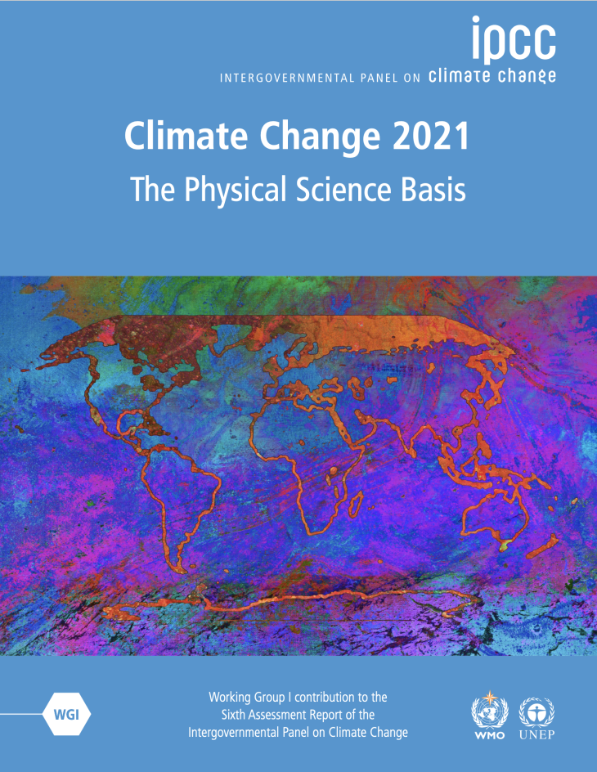
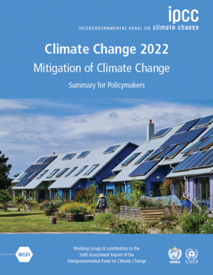
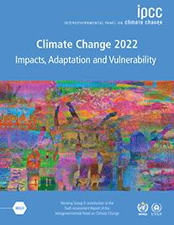
Results from the IPCC assessment reports AR6

Slide 4
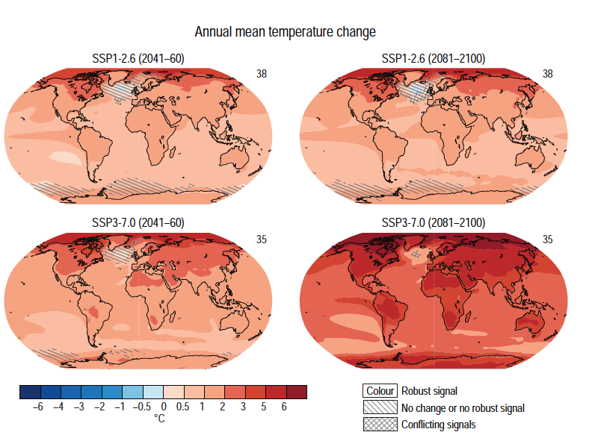
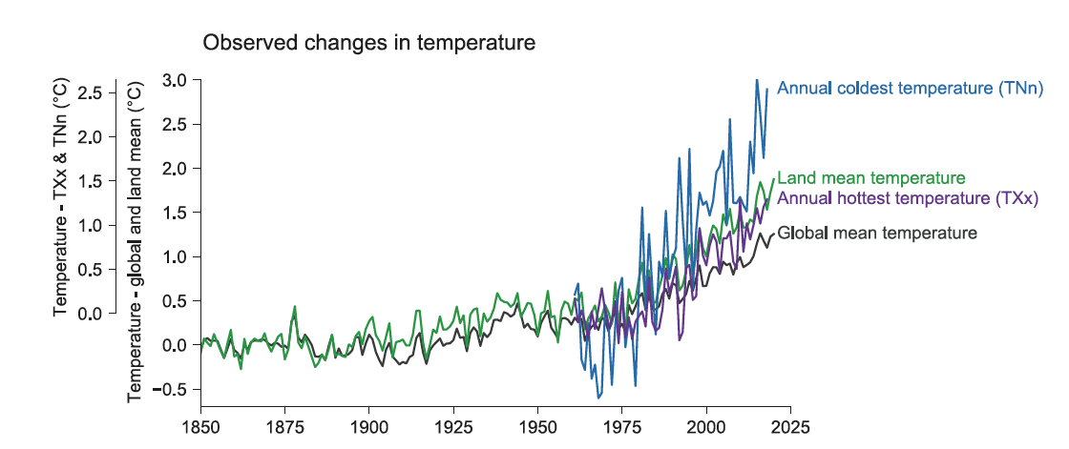
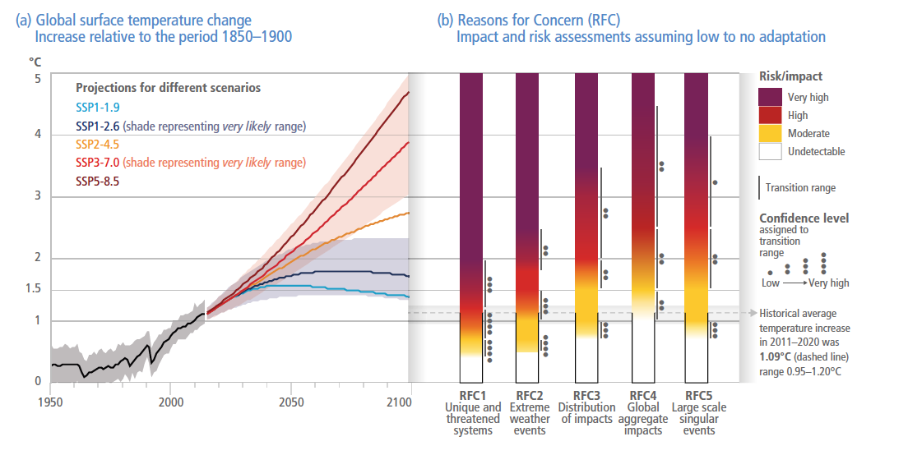
Mean climate, extreme events and their impacts
Average values in space and time
Extreme values of weather and climate
Impacts of mean and extreme values on ecosystems and the human population

Slide 5
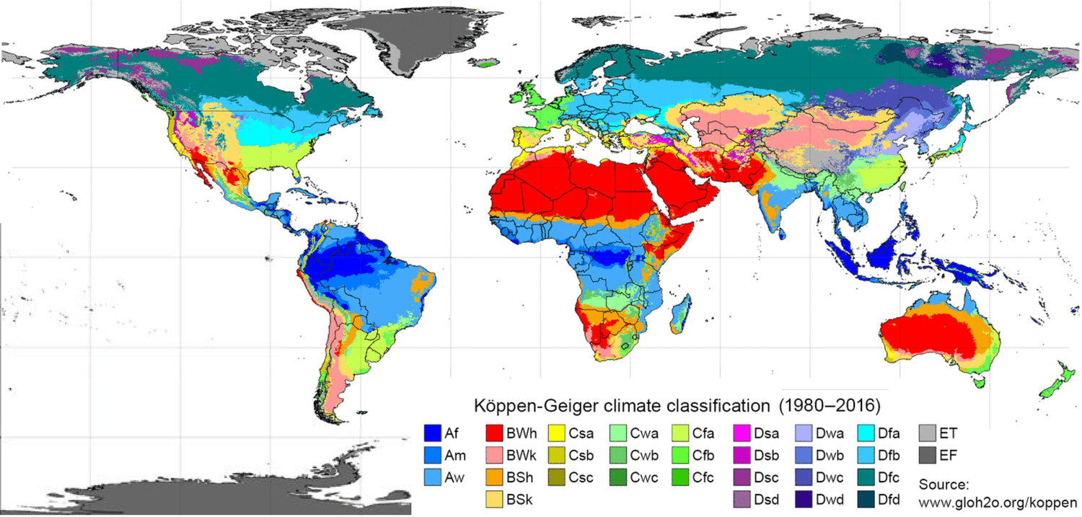
What defines climate?
Mean temperature
Mean precipitation
Seasonality of temperature and precipitation

Slide 6
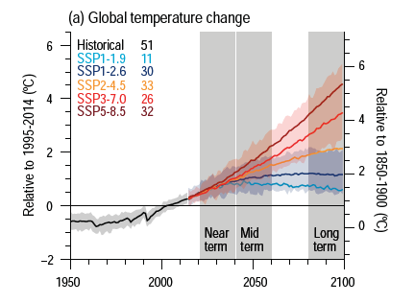
Projected increase in global temperature
More greenhouse gases – more heat trapped – more warming
Relatively low uncertainty
Remember SPP3-7.0 and SSP5-8.5 are reference scenarios and not consistent with current policies
Notes:
IPCC WGI, chapter 4, figure 4.2

Slide 7
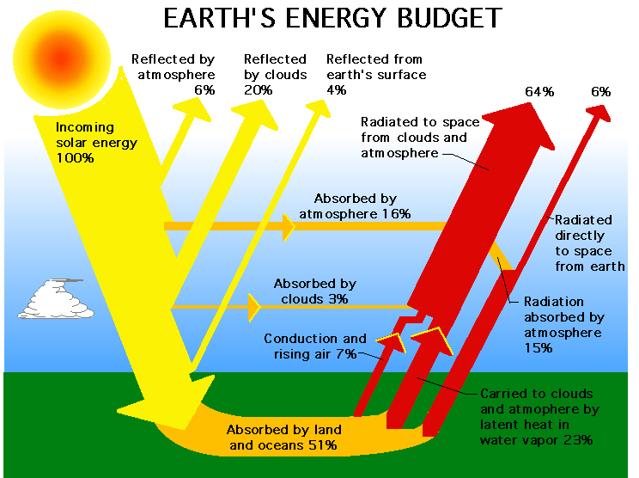

Slide 8
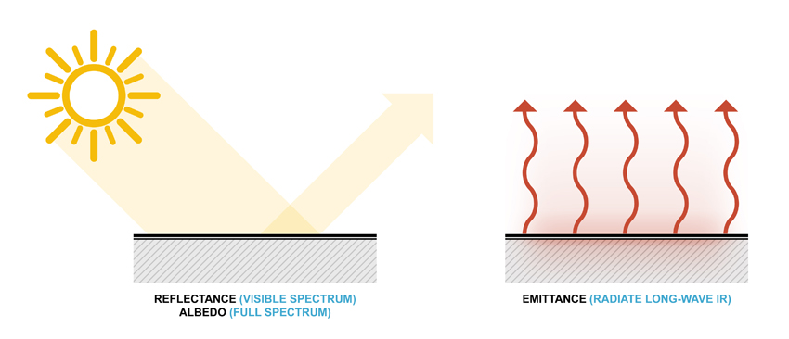
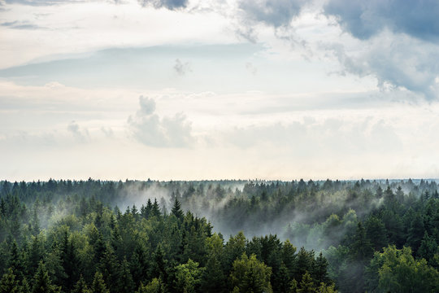
Temperature at the surface is driven by loss of heat at the surface
Sensible heat – heat transfer depends on the surface properties and temperature differential
Latent heat of evaporation – heat transfer depends on water on the surface and the temperature of the surface and the air

Slide 9
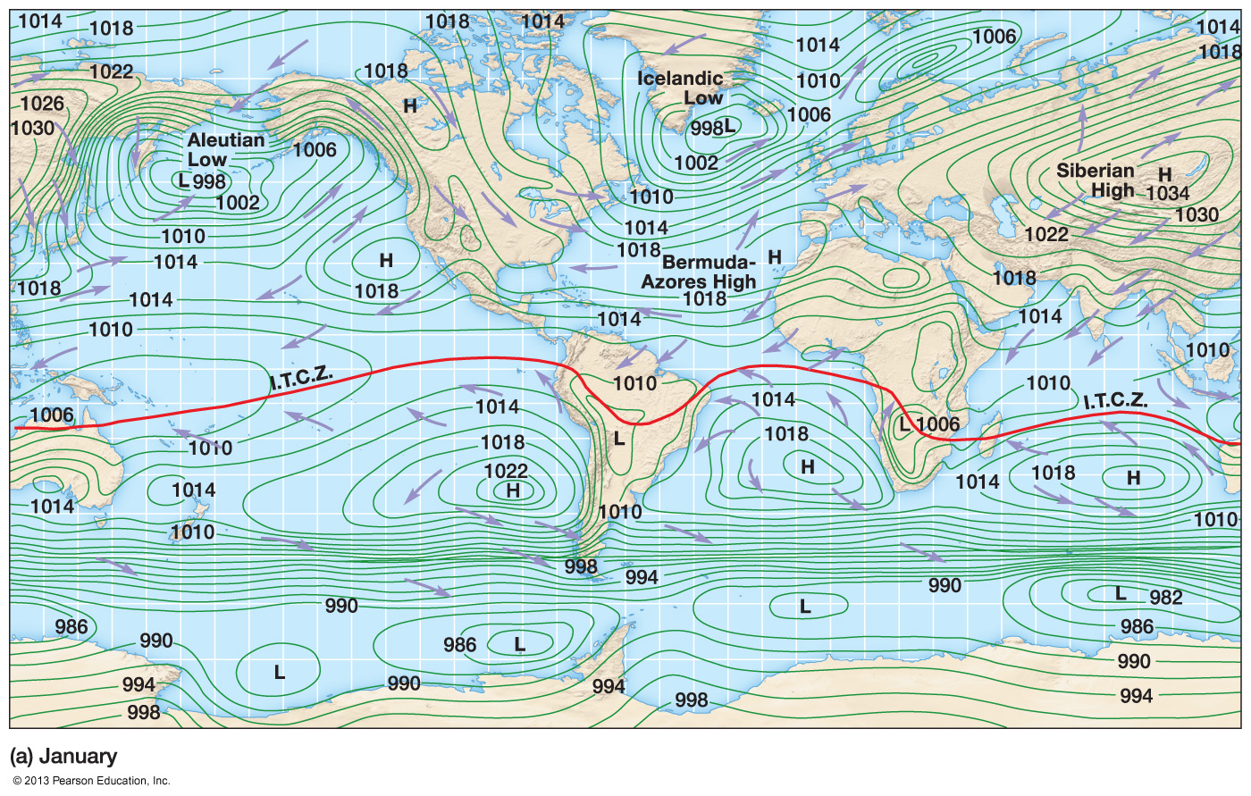
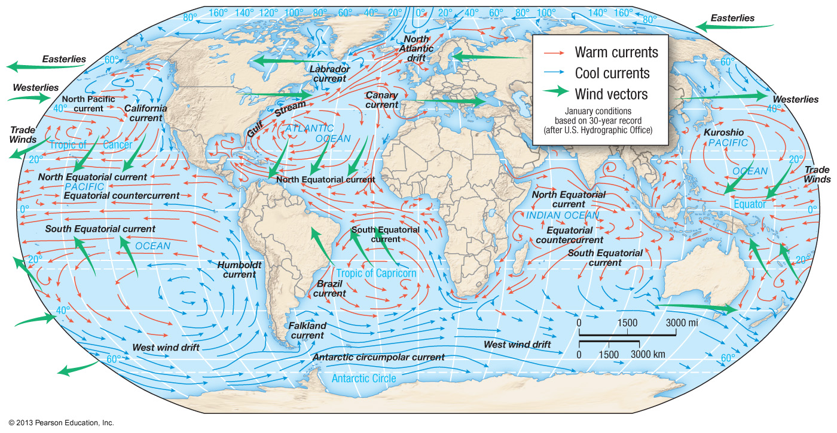
Global circulation driven by temperature and pressure
…and in turn affects temperature and precipitation

Slide 10
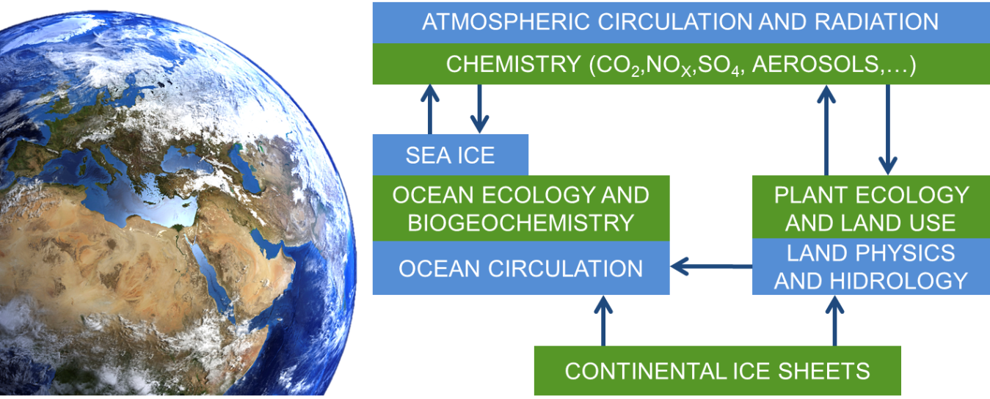
Too complex a system to infer consequences through logic, we need a model

Slide 11
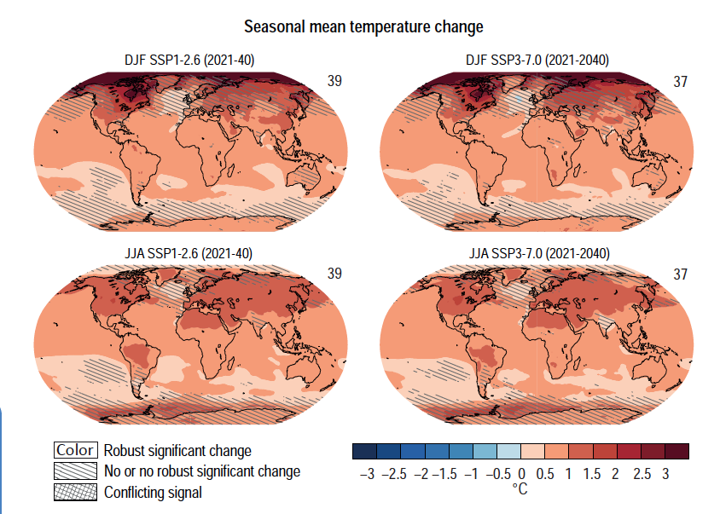
Near-term global surface temperature increase
Larger increase over land
Larger increase in the Northern hemisphere
Largest increase in the high Northern latitudes during boreal winter
Increase over Amazon basin during dry season
Notes:
IPCC WGI, chapter 4, figure 4.12

Slide 12
The land and ocean reflect, absorb and release heat differently
Sensible heat – heat transfer depends on the surface properties and temperature differential
Latent heat of evaporation – heat transfer depends on water on the surface and the temperature of the surface and the air

Slide 13
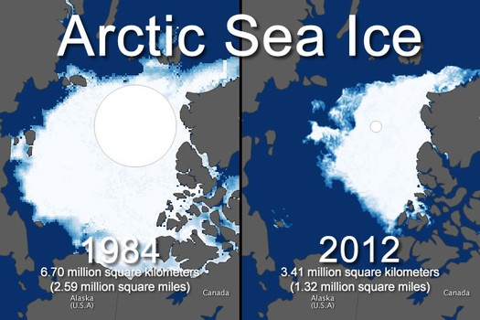
Change of albedo over the Arctic
Ice cap melt – reduction in albedo – more energy absorbed – higher temperature

Slide 14
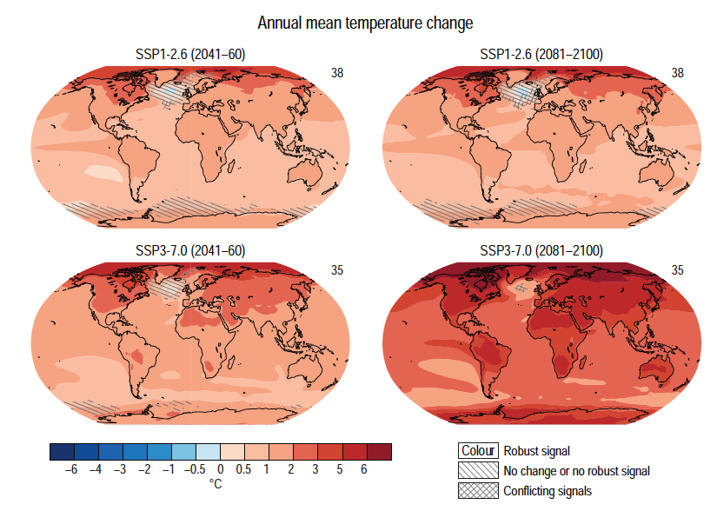
Mid- and long-term global surface temperature increase
Near-term patterns remain but increased magnitude
Further increase in subtropical regions even in the low end scenario
Notes:
IPCC WGI, chapter 4, figure 4.19

Slide 15
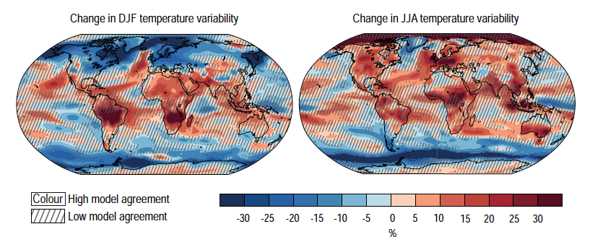
Long-term changes in inter-annual temperature variability
Large increase in year-to-year variability, mainly over land
Low model agreement – remember it’s hard to attribute variability
Notes:
IPCC WGI, chapter 4, figure 4.21

Slide 16
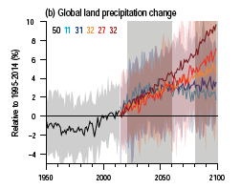
Changes in global precipitation
More greenhouse gases – more heat trapped – more change
Global increase in yearly precipitation
High uncertainty
Notes:
IPCC WGI, chapter 4, figure 4.2

Slide 17
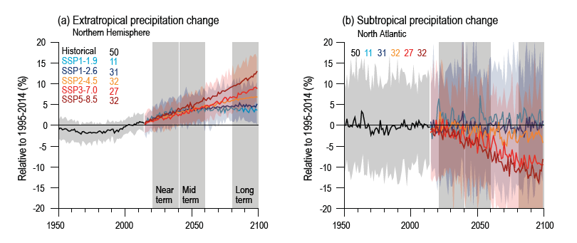
Regional changes in yearly precipitation
Increase in the higher latitudes but decrease closer to the tropics
Higher uncertainty in the low latitudes

Slide 18
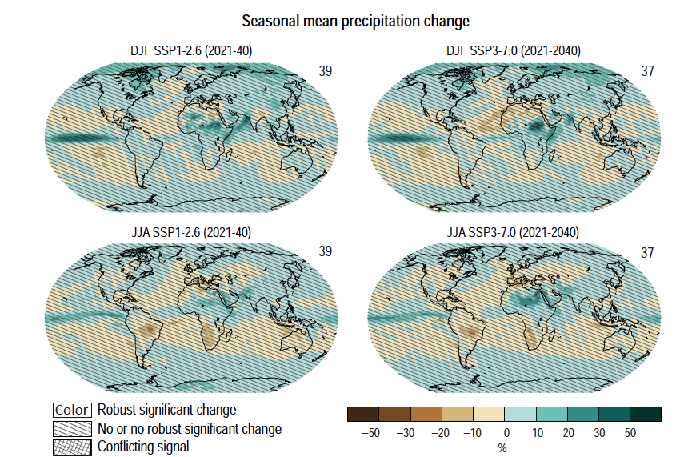
Near-term global precipitation change
Much higher uncertainty than temperature, across the globe
Drying in the Amazon corresponding to projected temperature increase
Decrease along the ITCZ
Increase in the Sahel due to monsoon shifts
Notes:
IPCC WGI, chapter 4, figure 4.13

Slide 19
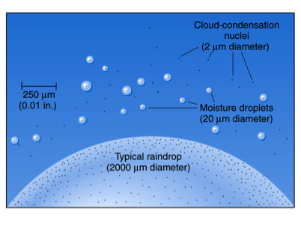
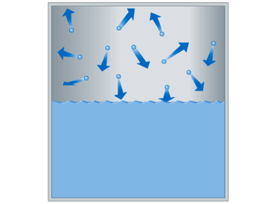
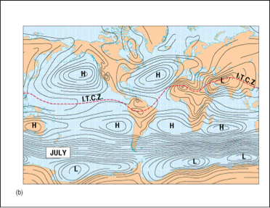
Uncertainty – the water cycle is complex
Evaporation and transpiration from pants
Circulation – where is the air mass coming from?
Cloud formation and atmospheric conditions

Slide 20
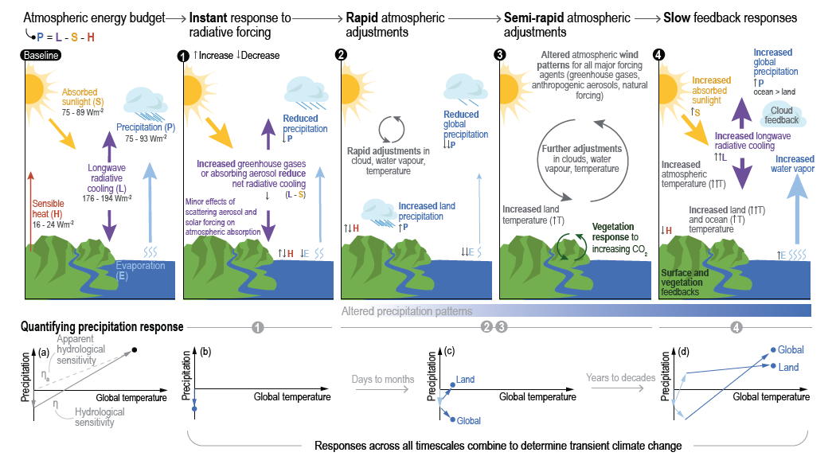
Notes:
IPCC WG I chapter 8, figure 8.3

Slide 21
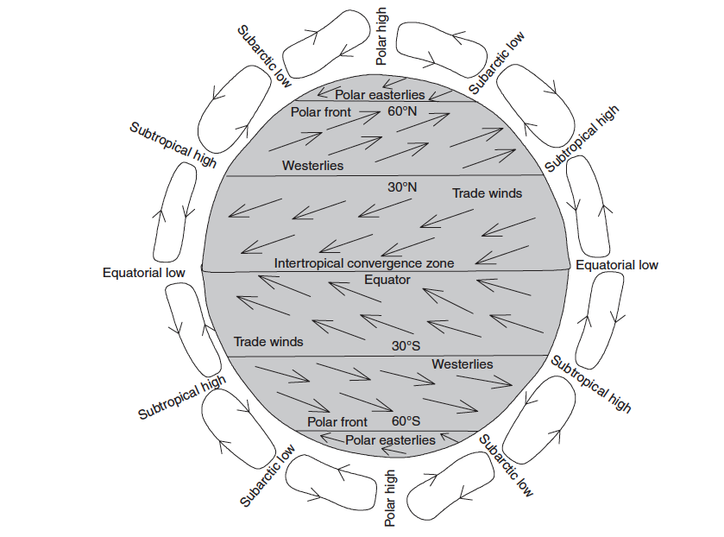
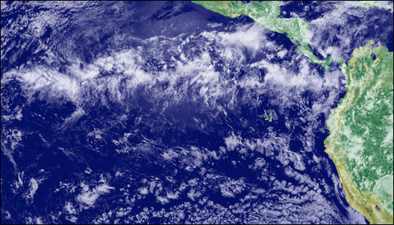
Intertropical convergence zone (ITCZ)
Convergence of northeast and southeast trade winds in equatorial regions creates the intertropical convergence zone

Slide 22
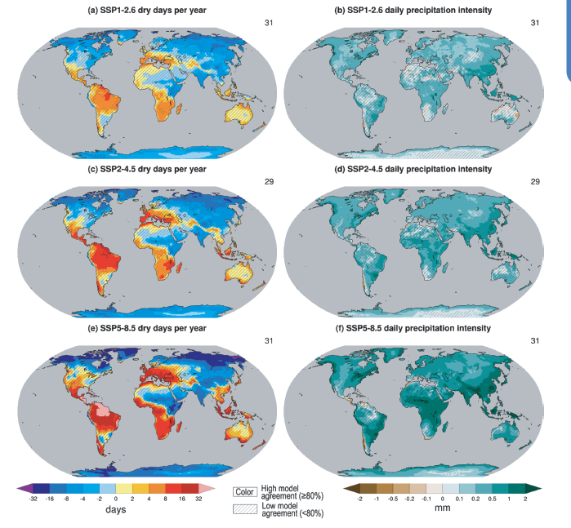
Frequency vs. intensity of precipitation
Notes:
IPCC WGI, chapter 8, figure 8.15

Slide 23
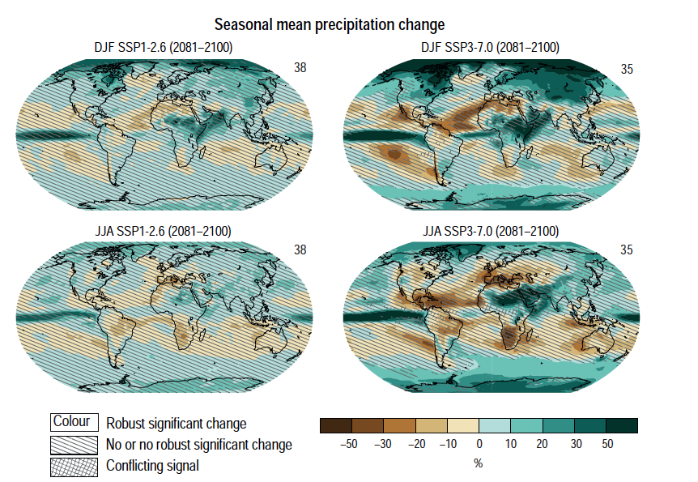
Mid- and long-term global precipitation change
Continued high uncertainty
Stronger changes in the high-end scenarios
Notes:
IPCC WGI, chapter 4, figure 4.24

Slide 24
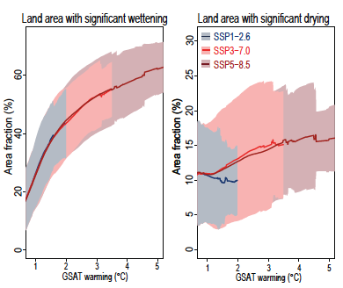
Changes in precipitation at different warming levels
A more intuitive way to look at water changes

Slide 25
How does average climate impact humans and ecosystems?
Extreme events like droughts and storms in future lectures!

Slide 26
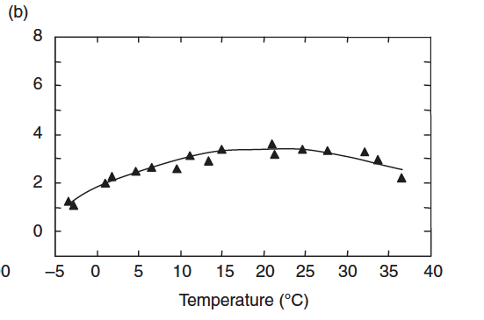
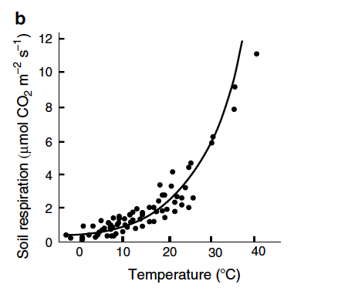
Biological systems have temperature optima
Biological systems – humans, organisms (including crops), ecosystems
Systems function less well/grow less as temperatures go higher
Reduction in the land carbon sink (but remember CO₂ fertilisation!)
Reduced crop yield

Slide 27
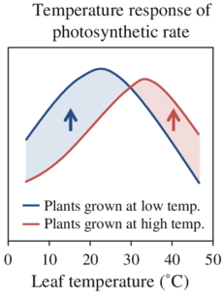
Acclimation to new conditions
Short term response to new conditions through changes in physiology, structure or behaviour
Has physiological limits
Not all organisms have the same capacity for acclimation

Slide 28
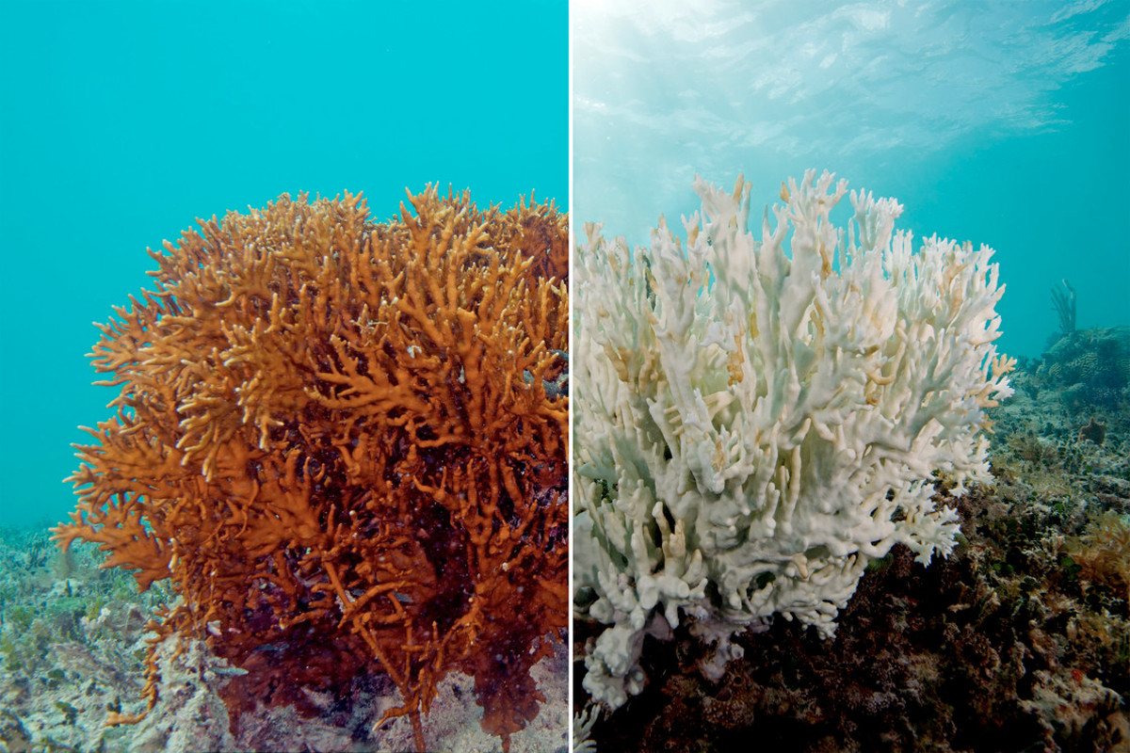
Coral bleaching
Under heat stress, corals will expel the algae from their tissues, causing discoloration
Not dead but prone to mortality

Slide 29
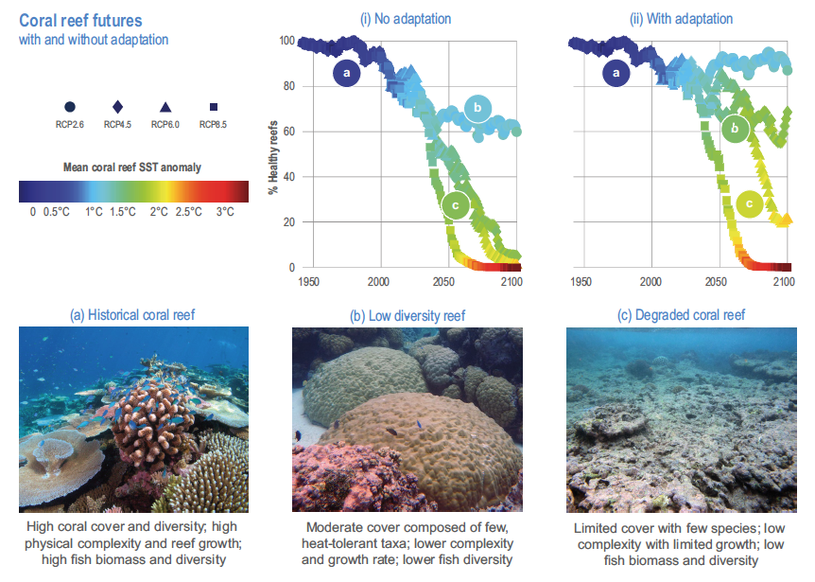
Notes:
IPCC WGII chapter 3 figure 3.13

Slide 30
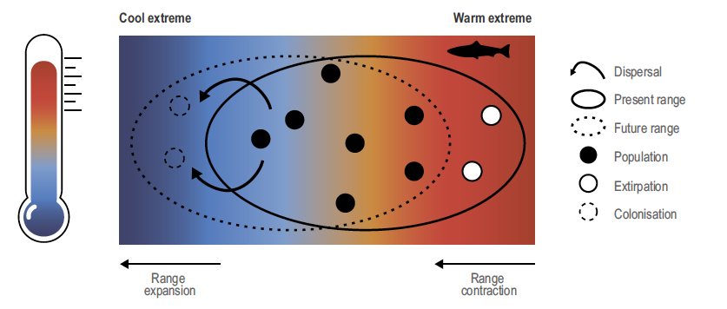
Species range shift
Species distributions can shift to places with a newly suitable climate
Generally a poleward shift with warming
Notes:
IPCC WGII chapter 3 figure 3.15

Slide 31
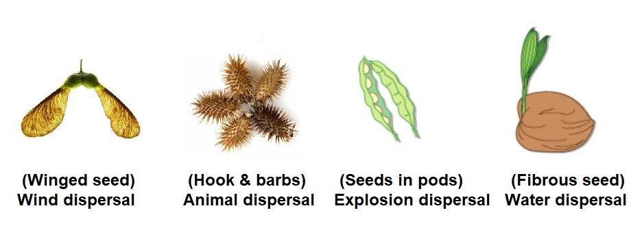
Limits to range shifts
Speed of dispersal: animals faster than plants and some plants better than others
Presence of dependent species and habitats. E.g. food sources, places to borrow etc.

Slide 32
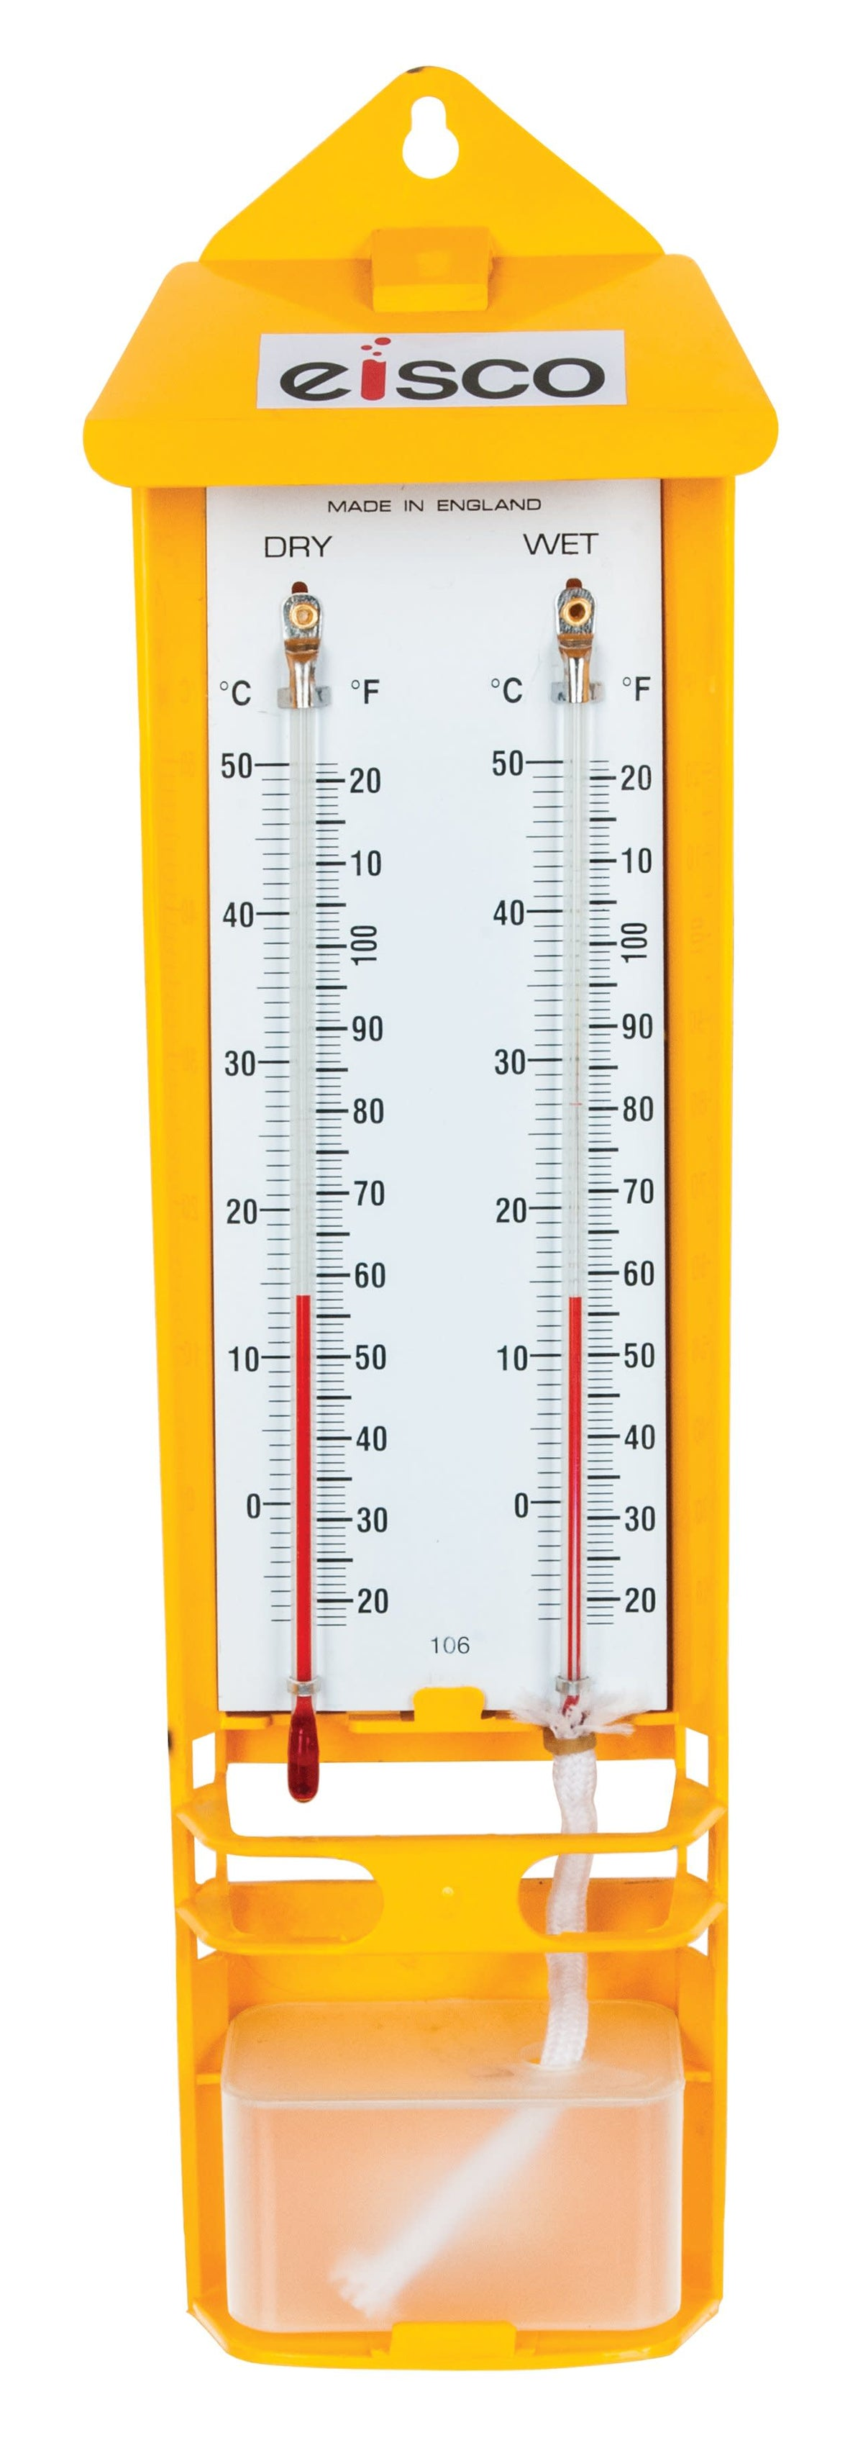
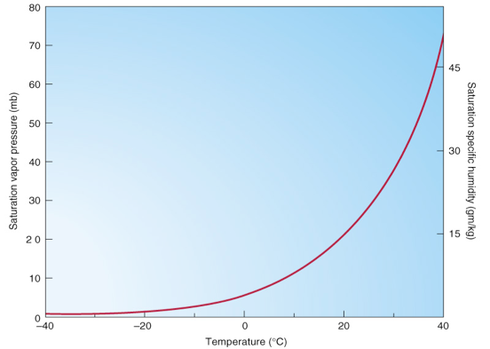
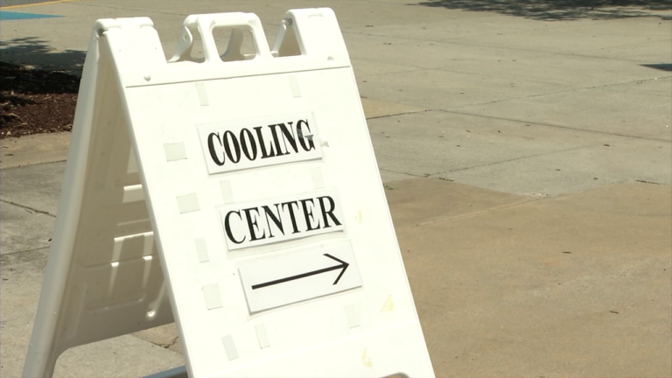
Human health
Human response to heat depends on both temperature and humidity
Warm air has higher humidity
Wet bulb temperatures >35 are dangerous to humans

Slide 33
Seasonality shifts
Seasons – spring/summer/autumn/winter or wet/dry – are defined by how warm it is on any given day and if/how much it rains
Even if there was uniform change in temperature and precipitation throughout the year, there will be a change in seasonality (timing of seasons)

Slide 34
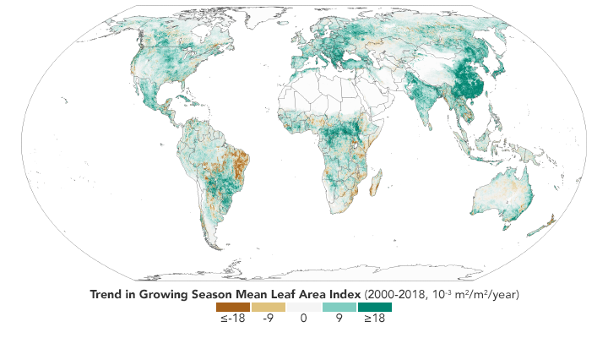
Seasonality shifts: global greening
Not all bad: longer growing seasons in temperate and boreal regions
Growing season (spring-autumn) defined by how warm it is

Slide 35
Seasonality shifts: global browning
Changes in dry season timing and length in the tropics and sub-tropics
Plants are adapted for dryness but often with a tight margin

Slide 36
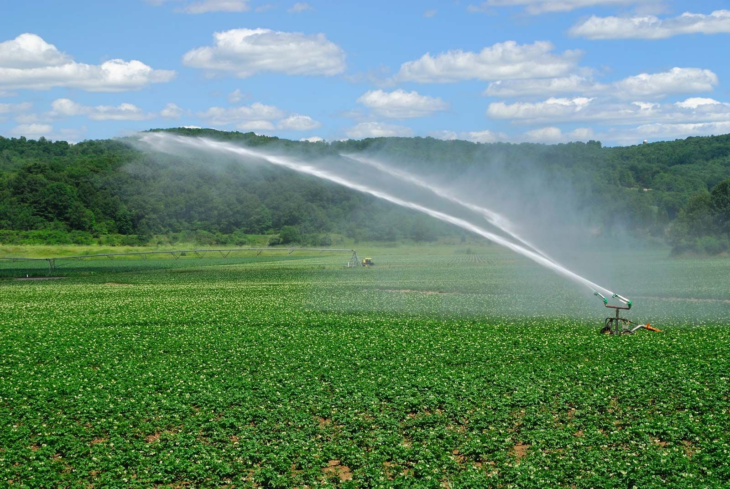
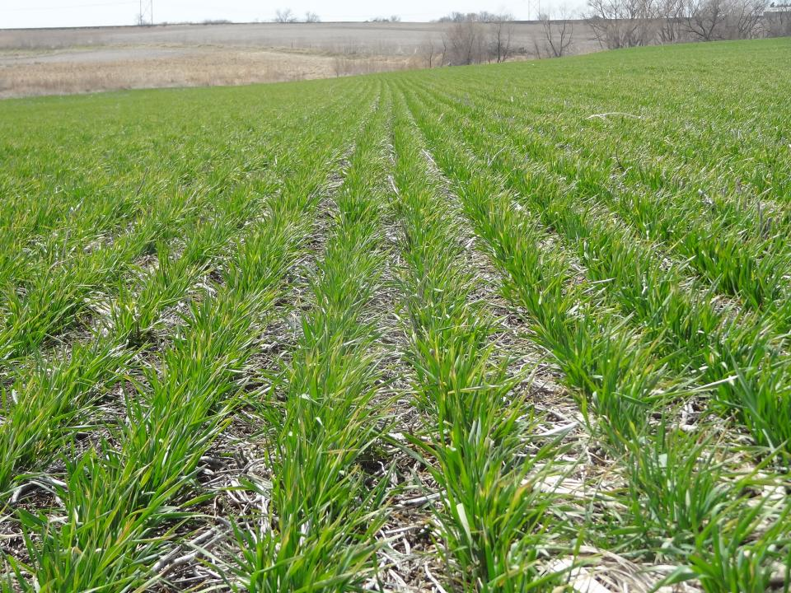
Seasonality shifts: agriculture
Agricultural planning relies on knowing approximately when the seasons are
Planning – what crops to grow and when to grow them, if, when and how much to irrigate

Slide 37
Atmosphere
Climate fundamentals
Predicting climate
Atmosphere
Global C cycle
IPCC report
Earth system models
Climate impacts
Climate solutions
Extreme events
Tipping points
Sea ice, ice caps
Energy
Mitigation
Nature-based solutions

